Slide 1
EC311 Final Project:
Breakout!
By: Astrid, Daniel, Loren, Sulaiman
Vivado Breakout™

Slide 2
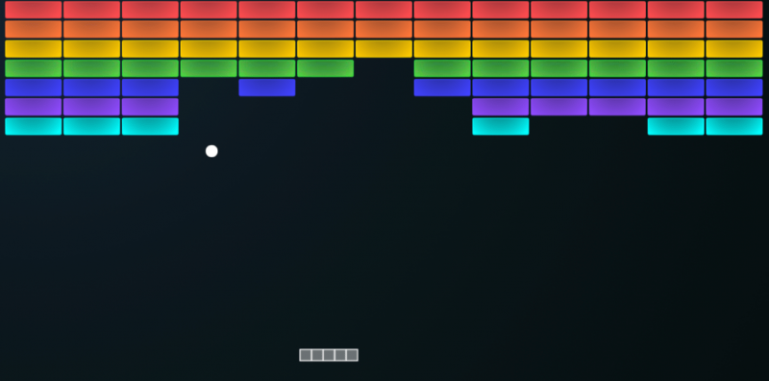
Goal/Motivation
To replicate the fan-favorite game Atari Breakout:)
Use a paddle and a ball to hit/break blocks
Breaking blocks increments your score
Missing the ball -> Game Over >:(
Atari Breakout
(Not ours)
Notes:
Daniel

Slide 3
Functionality
Using keyboard for inputs (arrow keys for left and right) to move the paddle accordingly
Display live score on seven segment display
Game is displayed on a monitor using a VGA
Hope to Add:
Different game mode/ difficulties using switches on the FPGA
Incrementing speed of ball after a block is broken
Notes:
Daniel

Slide 4
Specifications
Requirements
VGA to display the game
Controllable Paddle
Game start button, controls
Game physics/collision detection
Track score and display
Constraints
Time until due date
Ball speed limited by FPGA clock (likely minor)
Notes:
Astrid

Slide 5
Challenges / Uncharted Territory
Game Logic Implementation:
No previous experience with tracking ‘objects’ using verilog
Simulating wall bounce physics + breaking down what directions and “angles” should look like
Notes:
loren

Slide 6
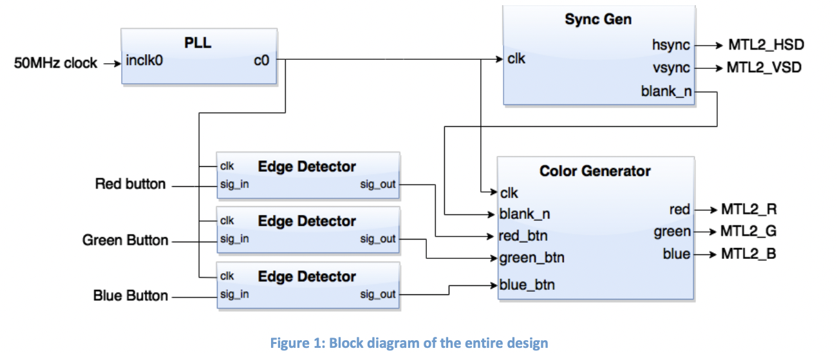
Challenges / Uncharted Territory
VGA:
No previous experience
New clock divider to worry about
Screen dimensions to consider
Has to interact with implemented game logic
Notes:
loren

Slide 7
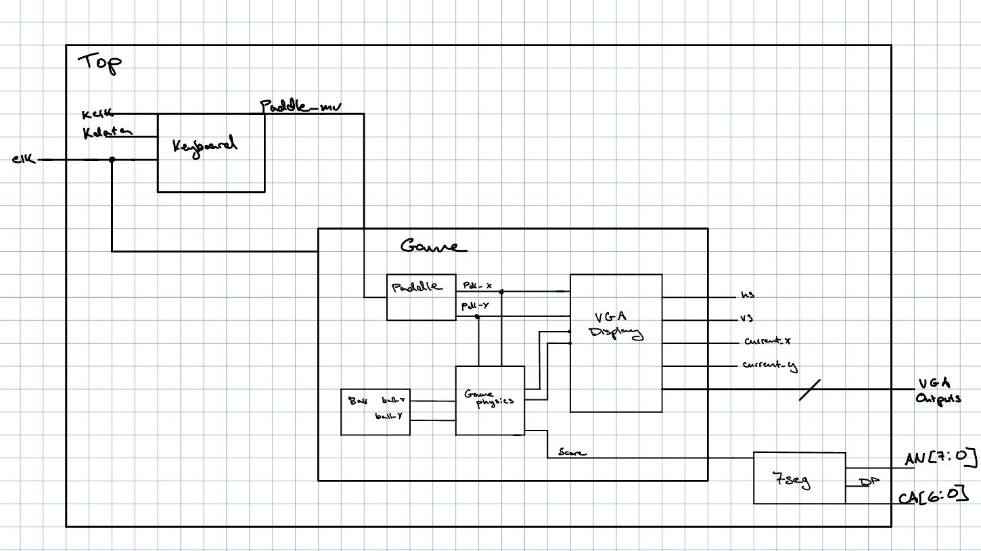
Block Diagram
Notes:
Daniel Sulaiman

Slide 8
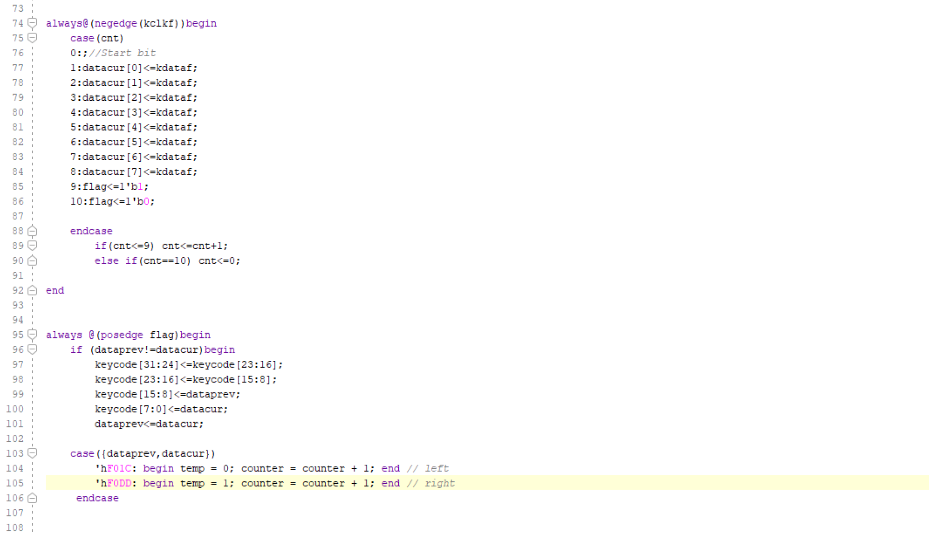
Code Snippet
Keyboard
Notes:
Sulaiman

Slide 9
Successes and failures
Failures:
PHO115 closed -> difficulty getting work done
Have not had much time to get things working
Make backup simulation project
Successes:
Project ideas/goals set
Found some resources to help -> pong code
Notes:
Astrid

